Slide 1
"Enhancing Road Safety: A Comprehensive Analysis of US Traffic Accidents"
Presented by-
Sakib Hosen Himel
Urban Technology-2023

Slide 2
Problem Setting
Explain Problem Setting:
The project focuses on analysing and extracting insights from a countrywide car accident dataset (Kaggle) between February 2016 and March 2023 , that covers 49 states of the USA. The analysis is divided into three parts, (1)- countrywide analysis and (2)- a detailed analysis of Miami city, which has highest accident rates and (3) predictions using machine learning models.
Motivation:
Accidents on the road a big problems for everyone. By understanding why this happen, we can make better decisions to keep people safe. It also help for informed policymaking, and emergency response. This project is all about finding insights that can help make our roads safer.
Highlight State-of-the-Art Approaches
In this project, I tried different methodologies, including advanced analytics and machine learning models, to analyze traffic accidents data. By considering a range of factors like geography, time, weather, and detailed descriptions, aimed to provide a clear understanding of accident patterns.

Slide 3
Overview
Countrywide Analysis:
What are the U.S. States with the Highest Number of Accidents.
What are the U.S. Cities with the Highest Number of Accidents.
No of Road Accidents for different Timezones in US.
What is the trend of accidents by year from 2016 to 2023?
What is the trend of accidents per months by year from 2016 to 2023?
What is the no. of / avg accidents monthly (2016-2023)?
Which days of the week have a higher probability of accidents?
What is the distribution of accidents throughout the day, and are there specific hours when accidents are more likely to occur?
Breakdown of Accident Severity(Percentagewise) & Trend of Severity Level by Year.
What are the most frequent words in the descriptions of severity 4 as well 2 accidents?
What are the top weather conditions that contribute to the accidents?
Is there any effect of Temperature on accidents?
Is there any effect of Humidity on accidents?
Miami City Analysis:
Timeseries Analysis of the accidents in Miami city, analysis by year, month, day of the week, and hour of the day.
Which Miami streets are the most vulnerable to accidents?
Which streets cause higher delay time & different level accident severities?
Present the distribution of Accidents on the Miami City map.
(AutoGulon) Model Implementation to Predict different level of Severity.

Slide 4
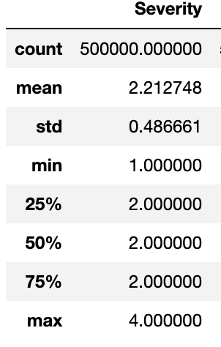
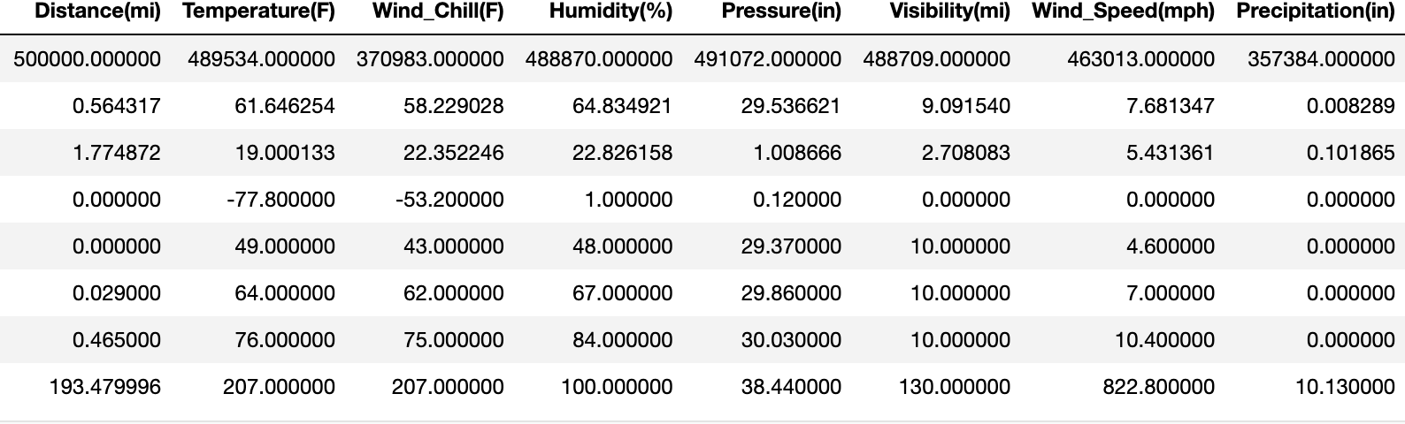
Descriptive Statistics
Severity Distribution: Most accidents have a severity level of 2, with a mean severity of approximately 2.21.
Weather Conditions: Mean temperature is around 61.65°F, and wind chill varies with a mean of 58.23°F.
Distance and Visibility: Mean accident distance is 0.56 miles, and 75% of incidents have visibility levels of 10 miles or more, suggests that a majority of the accidents occurred in conditions where visibility was relatively good.
Weather Impact: Precipitation is generally low (mean of 0.008 inches), and wind speed has a mean of 7.68 mph (with a potential outlier).

Slide 5
Countrywide Analysis

Slide 6
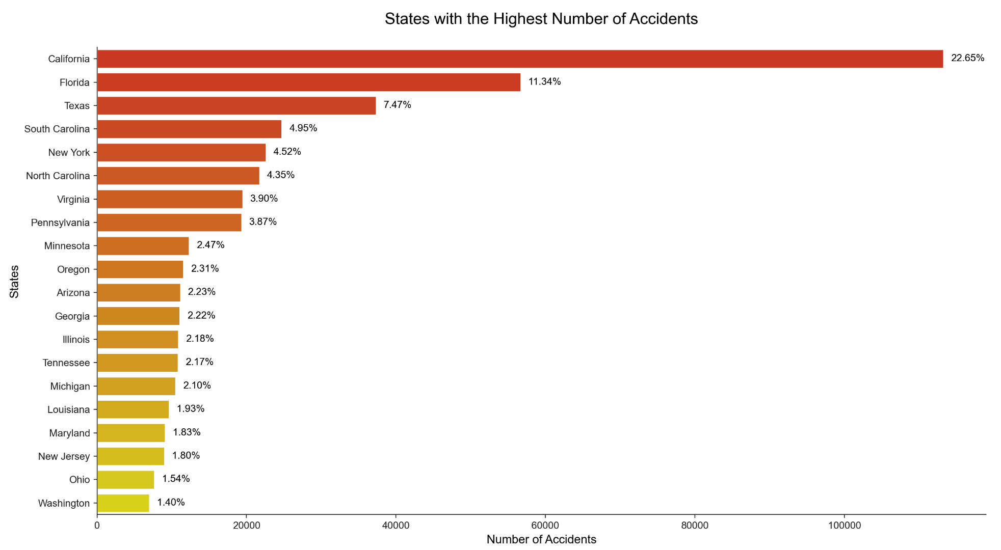
What are the U.S. States with the Highest Number of Accidents.
We can see from the bar chart, California has the highest number of accidents, followed by Florida and Texas.

Slide 7
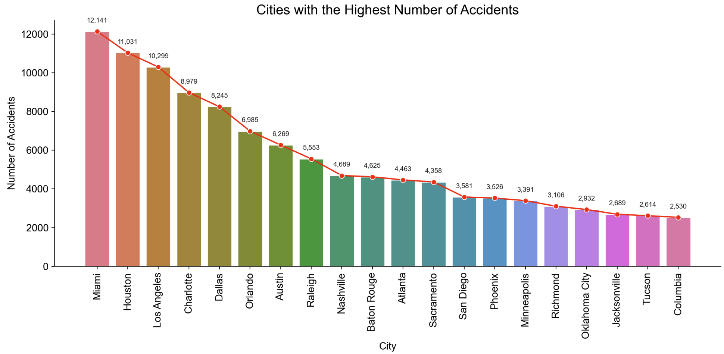
What are the U.S. Cities with the Highest Number of Accidents.
we can see from the bar chart, Miami has the highest number of accidents, followed by Houston and Los Angelese.

Slide 8
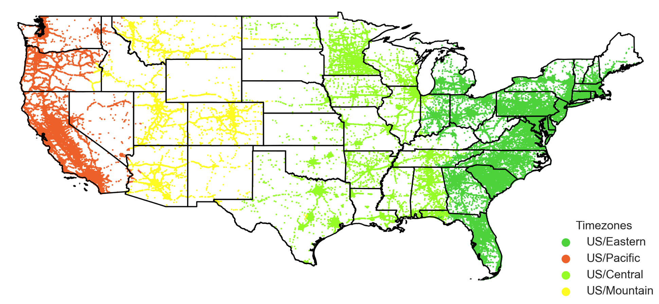
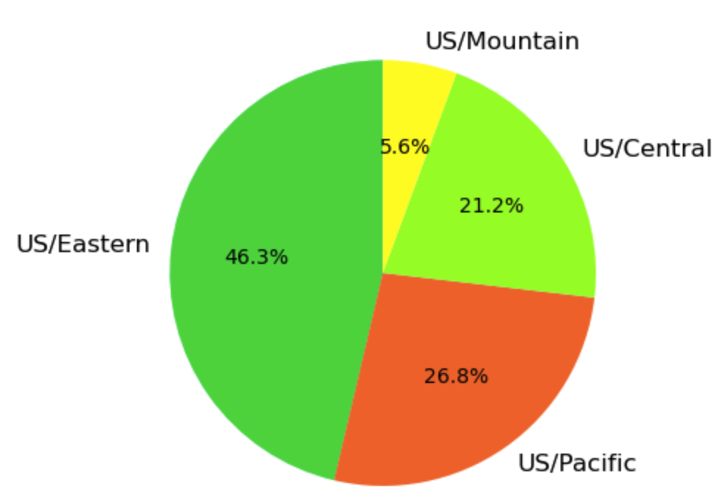
No of Road Accidents for different Time zones in US.
Eastern time zone region of US has the highest no. of road accident cases (46.3%).
Mountain time zone region of US has the lowest no. of road accident cases (5.6%).

Slide 9
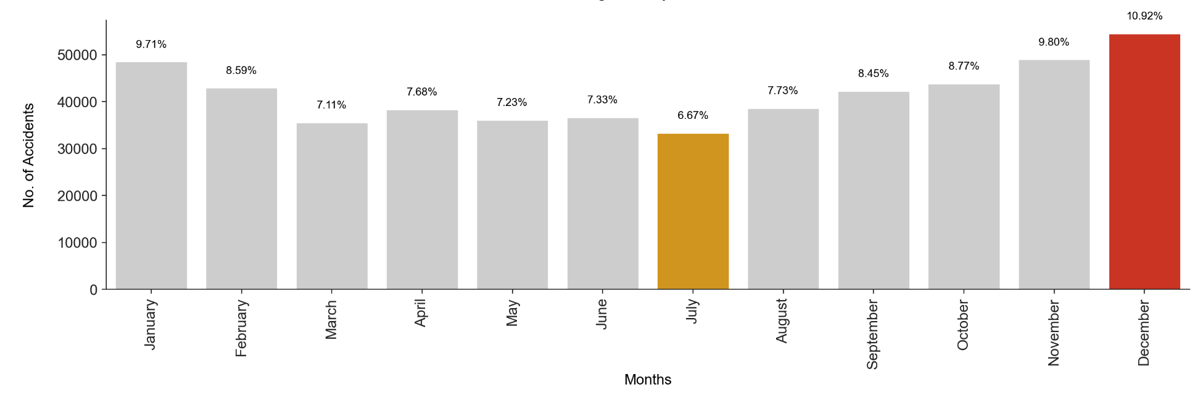
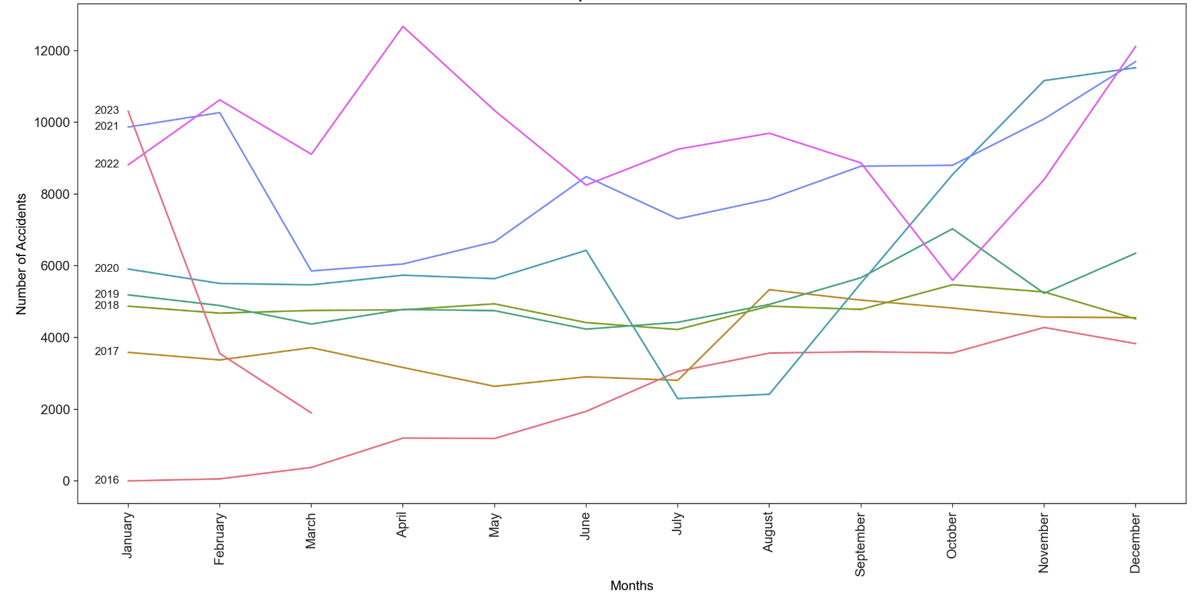
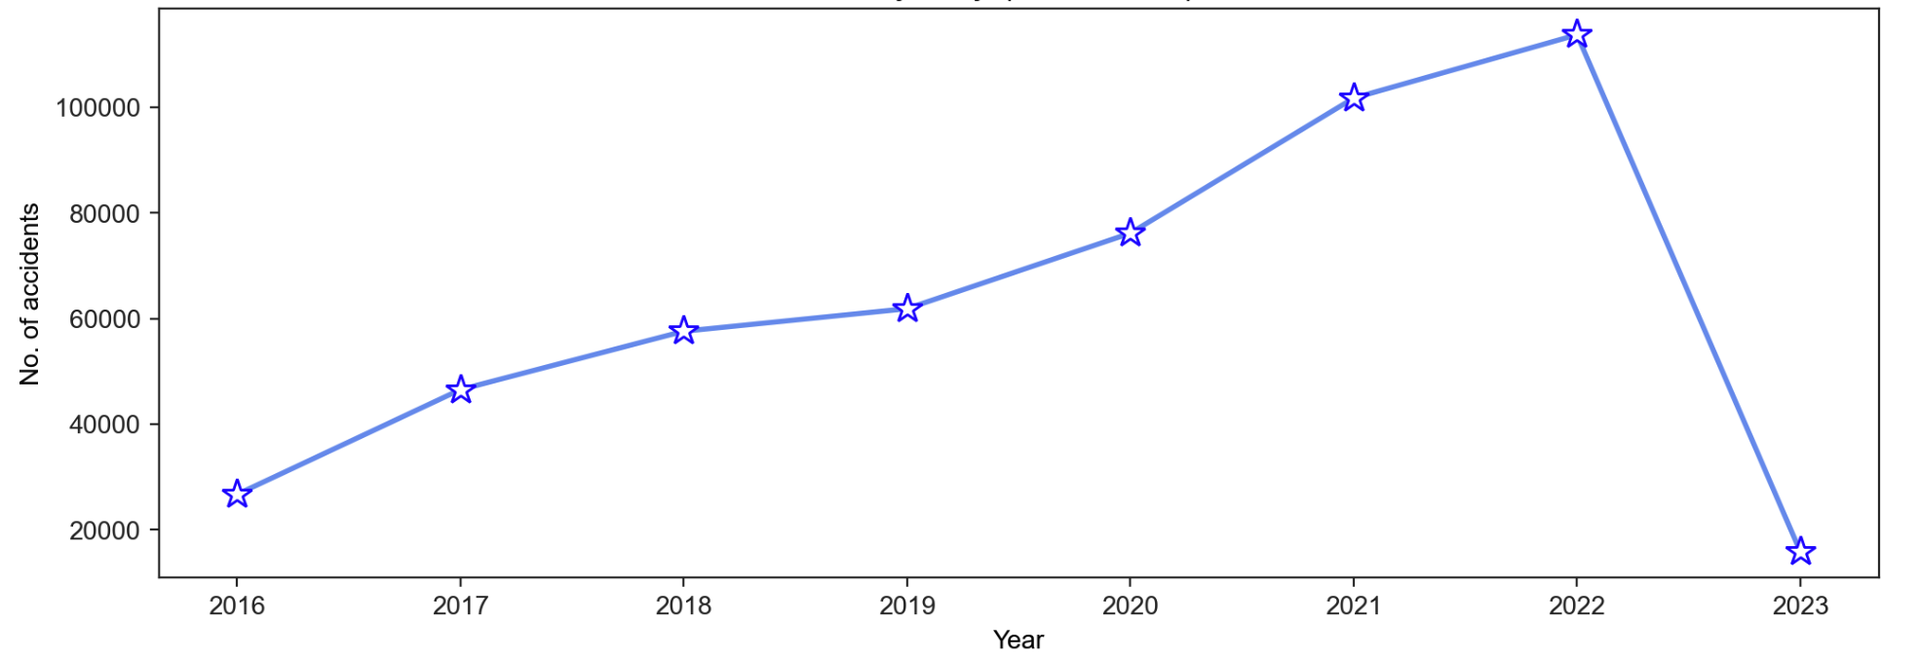
What is the trend of accidents , per months, by year and average accidents monthly from 2016 to 2023?

Slide 10
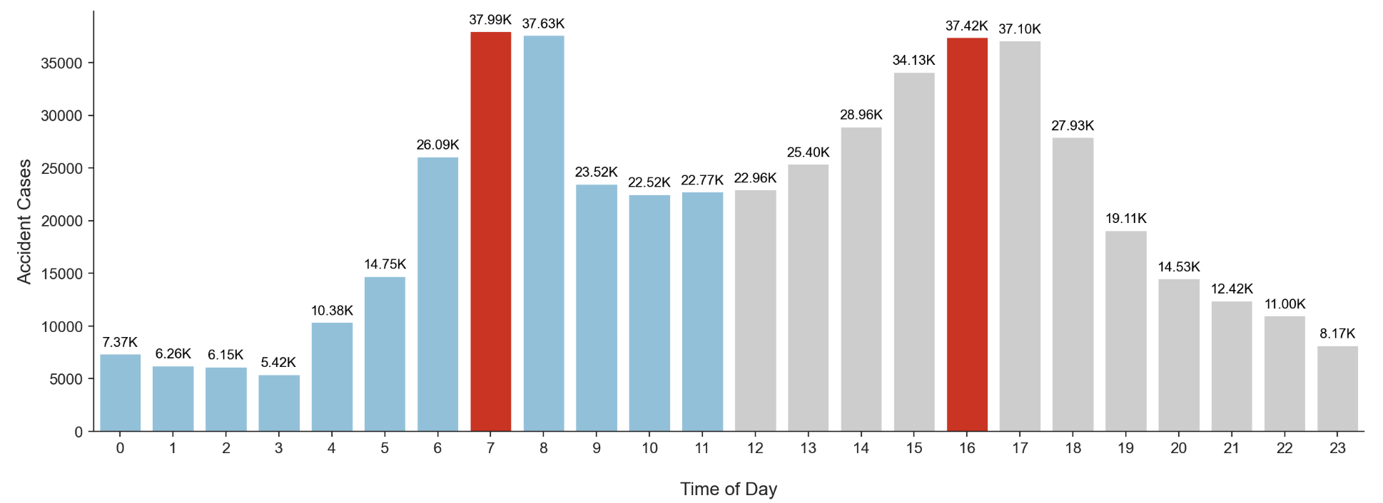
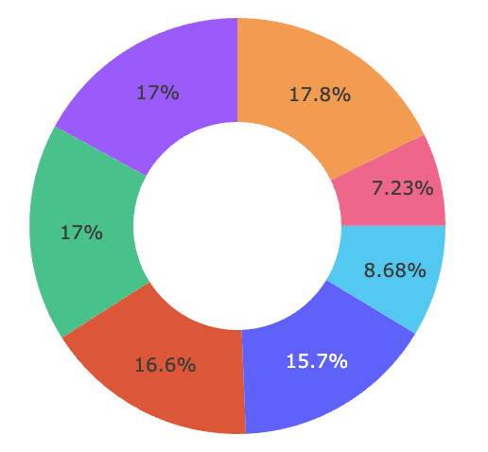
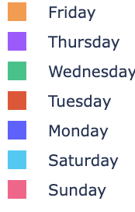
Which days of the week have a higher probability of accidents? What is the distribution of accidents throughout the day, and are there specific hours when accidents are more likely to occur?
In the early morning hours (around 7 AM) and the evening hours (around 4 PM) are associated with the highest number of accidents, with each time experienced more than 37,000 accidents on average.
Weekdays experience significantly more accidents compared to weekends, with weekend accident frequencies being at least 2/3 times lower.

Slide 11
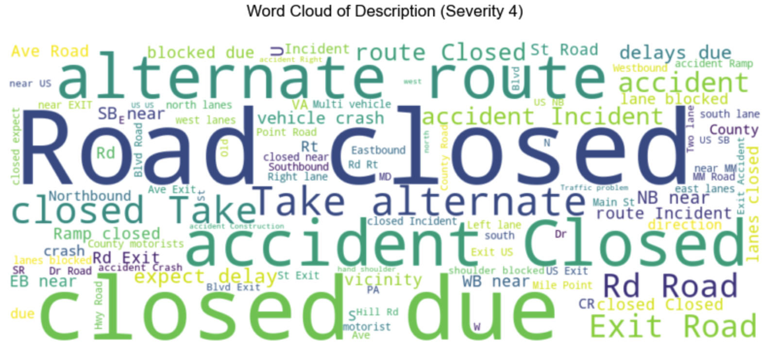
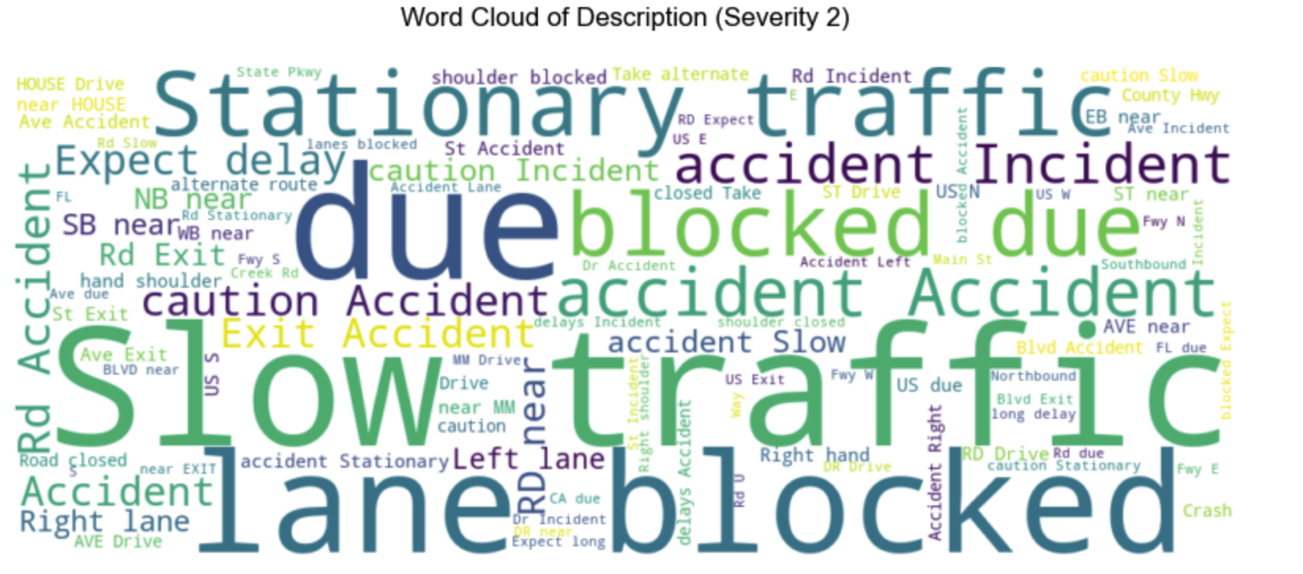
What are the most frequent words in the descriptions of severity 4 and 2 level accidents?

Slide 12
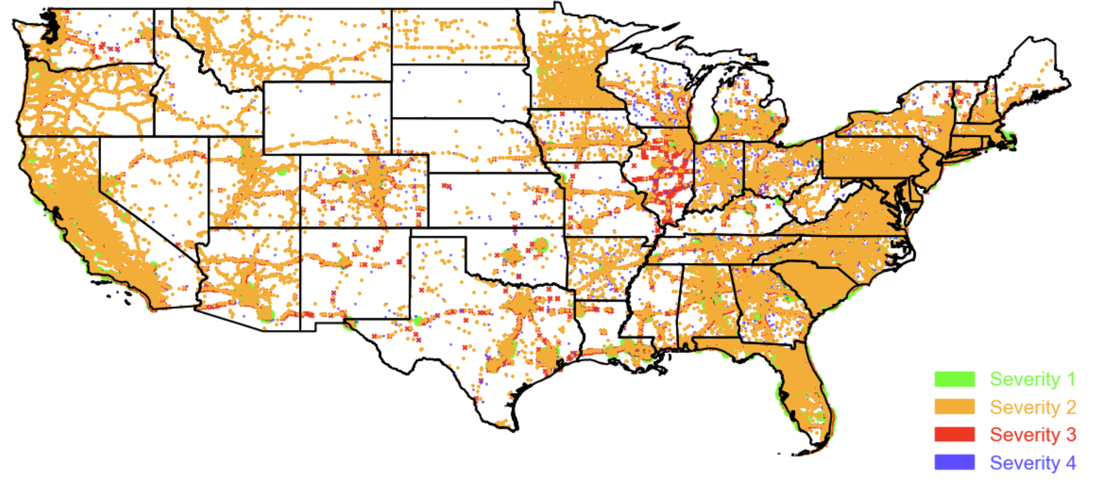
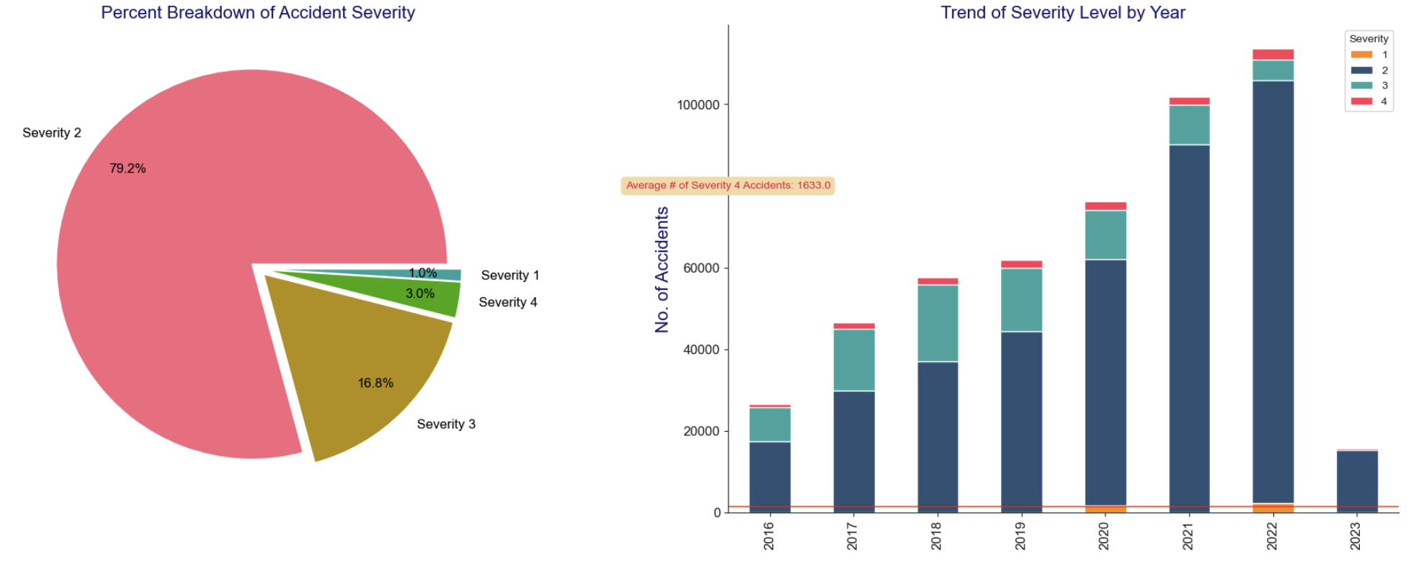
Breakdown of Accident Severity(Percentagewise) & Trend of Severity Level by Year.

Slide 13
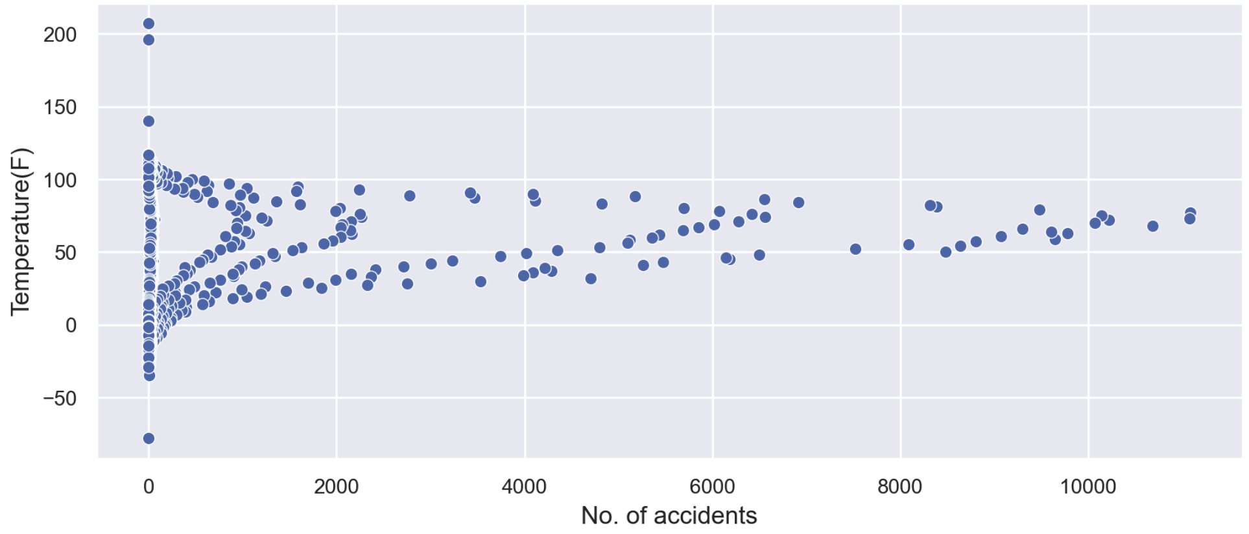
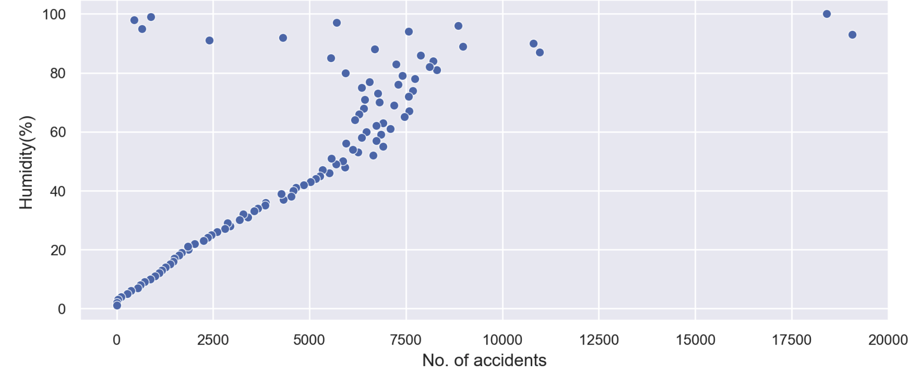
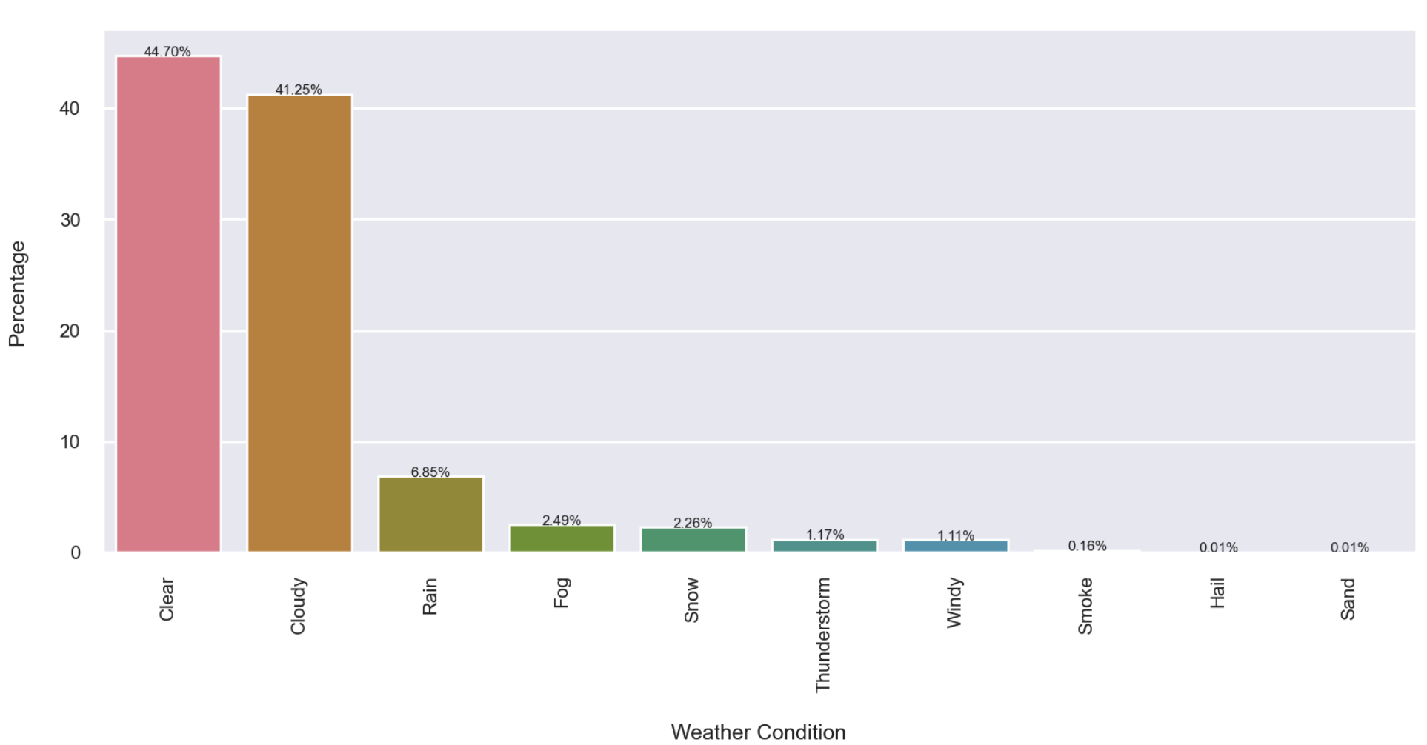
What are the top weather conditions that contribute to the accidents? Is there any effect of Temperature and Humidity on accidents?

Slide 14
Miami City Analysis

Slide 15
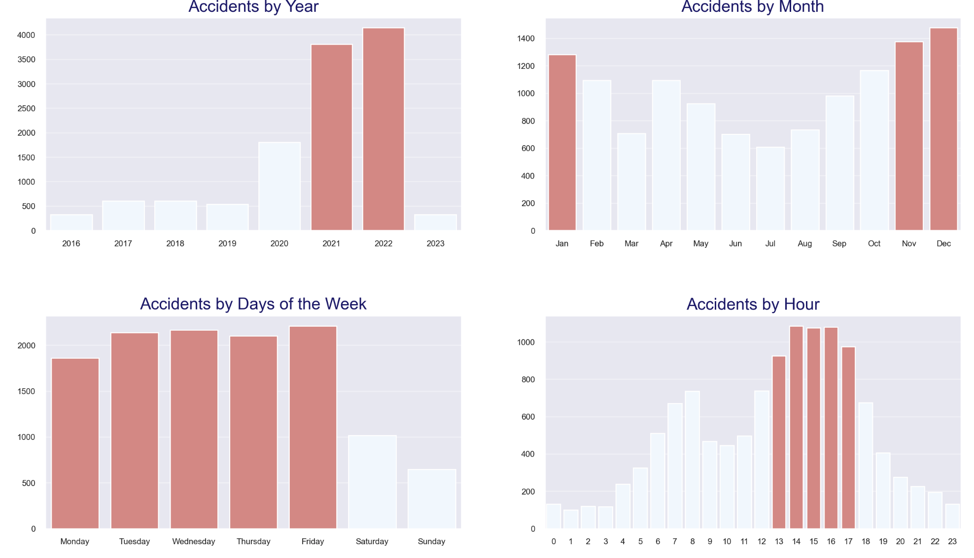
Timeseries Analysis of the accidents in Miami city, analysis by year, month, day of the week, and hour of the day.

Slide 16
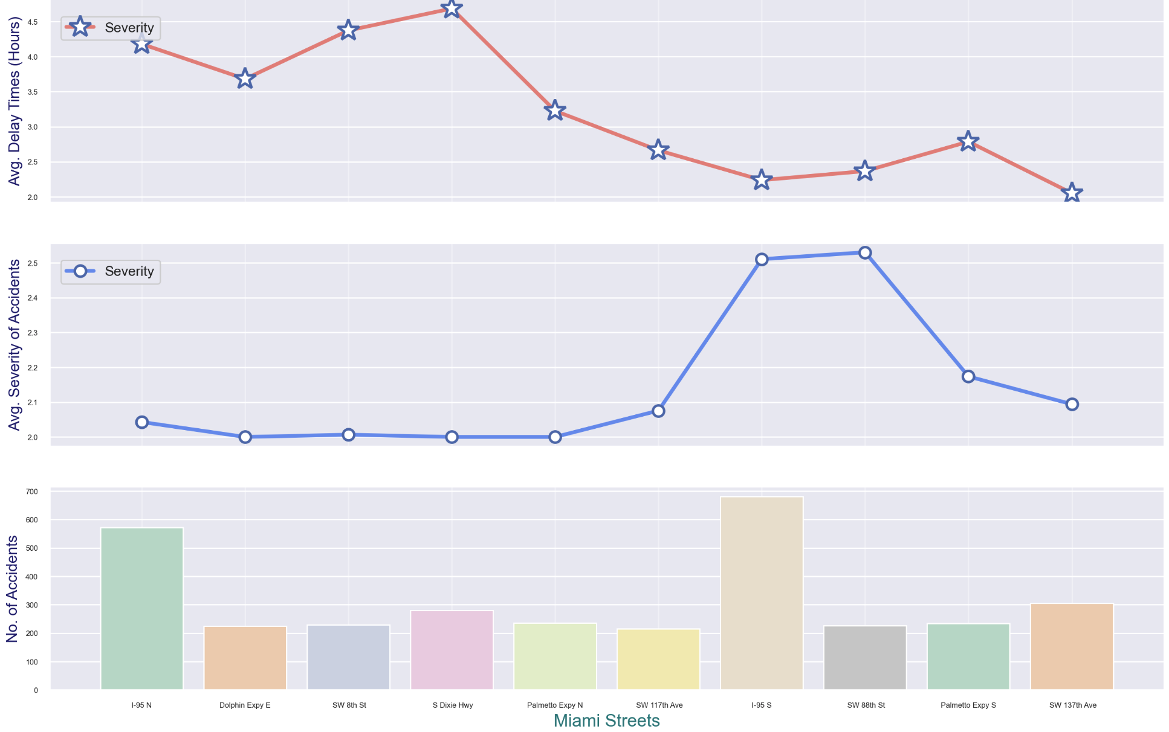
Which Miami streets are the most vulnerable to accidents? Which streets cause higher delay time & different level accident severities?

Slide 17
MACHINE LEARNING MODEL

Slide 18
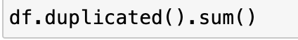
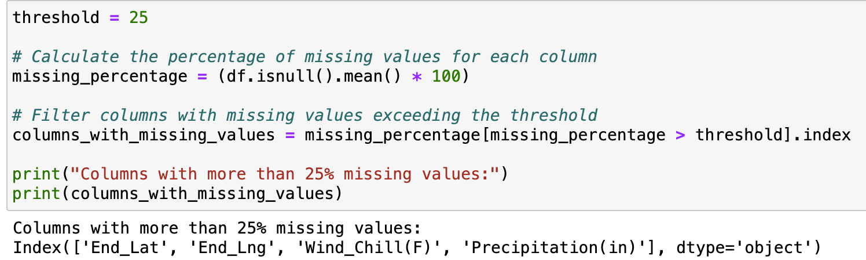
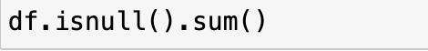
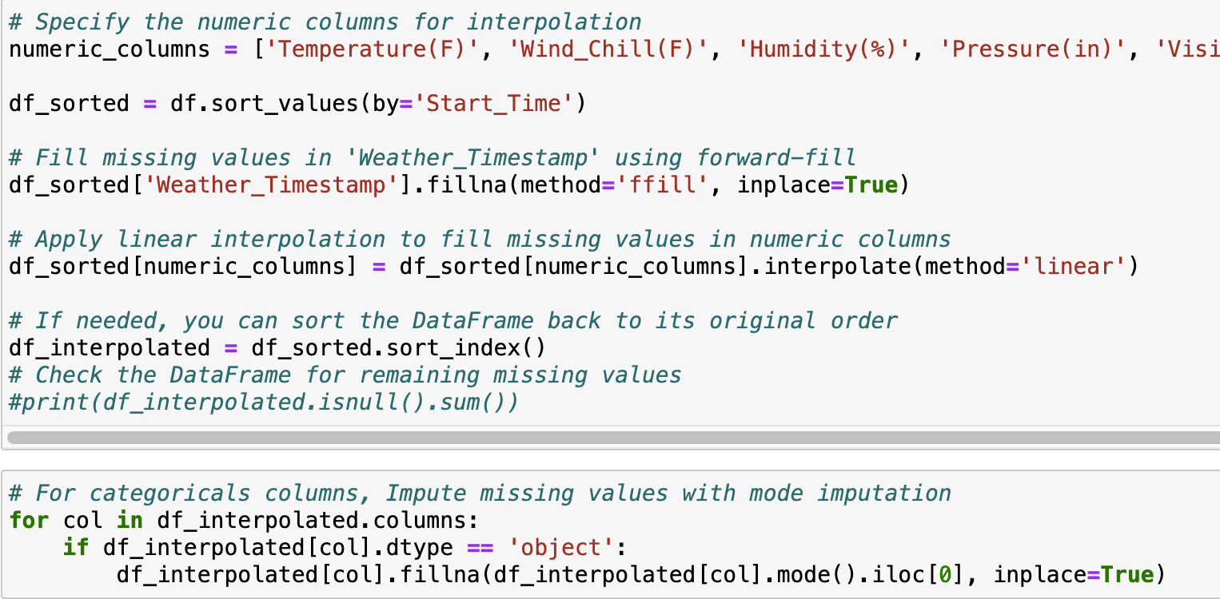
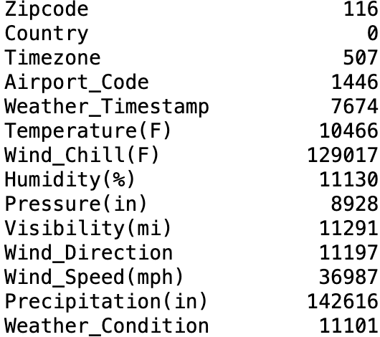
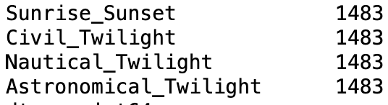
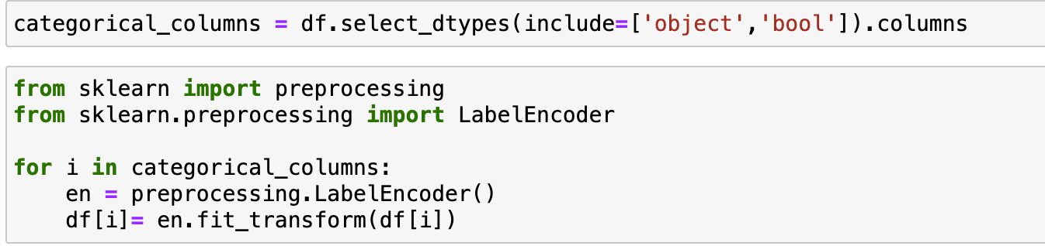
Data Preprocessing

Slide 19
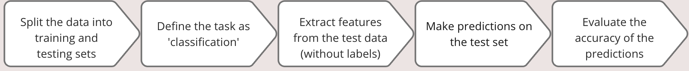
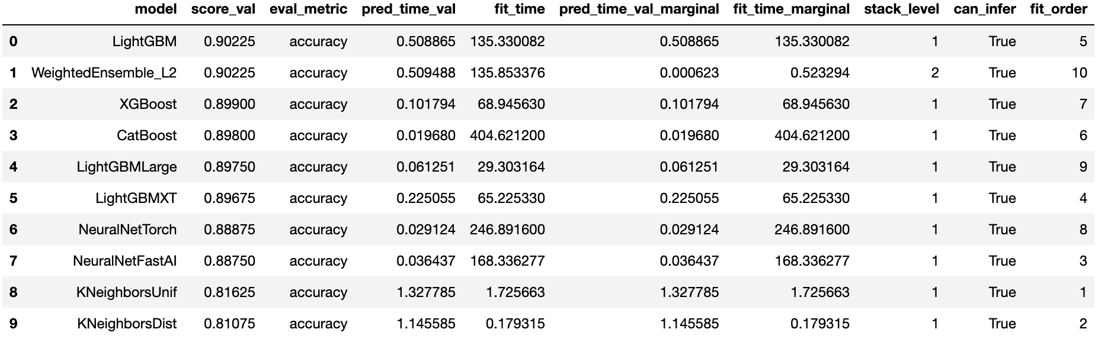
AutoGluon Model & Test Score

Slide 20
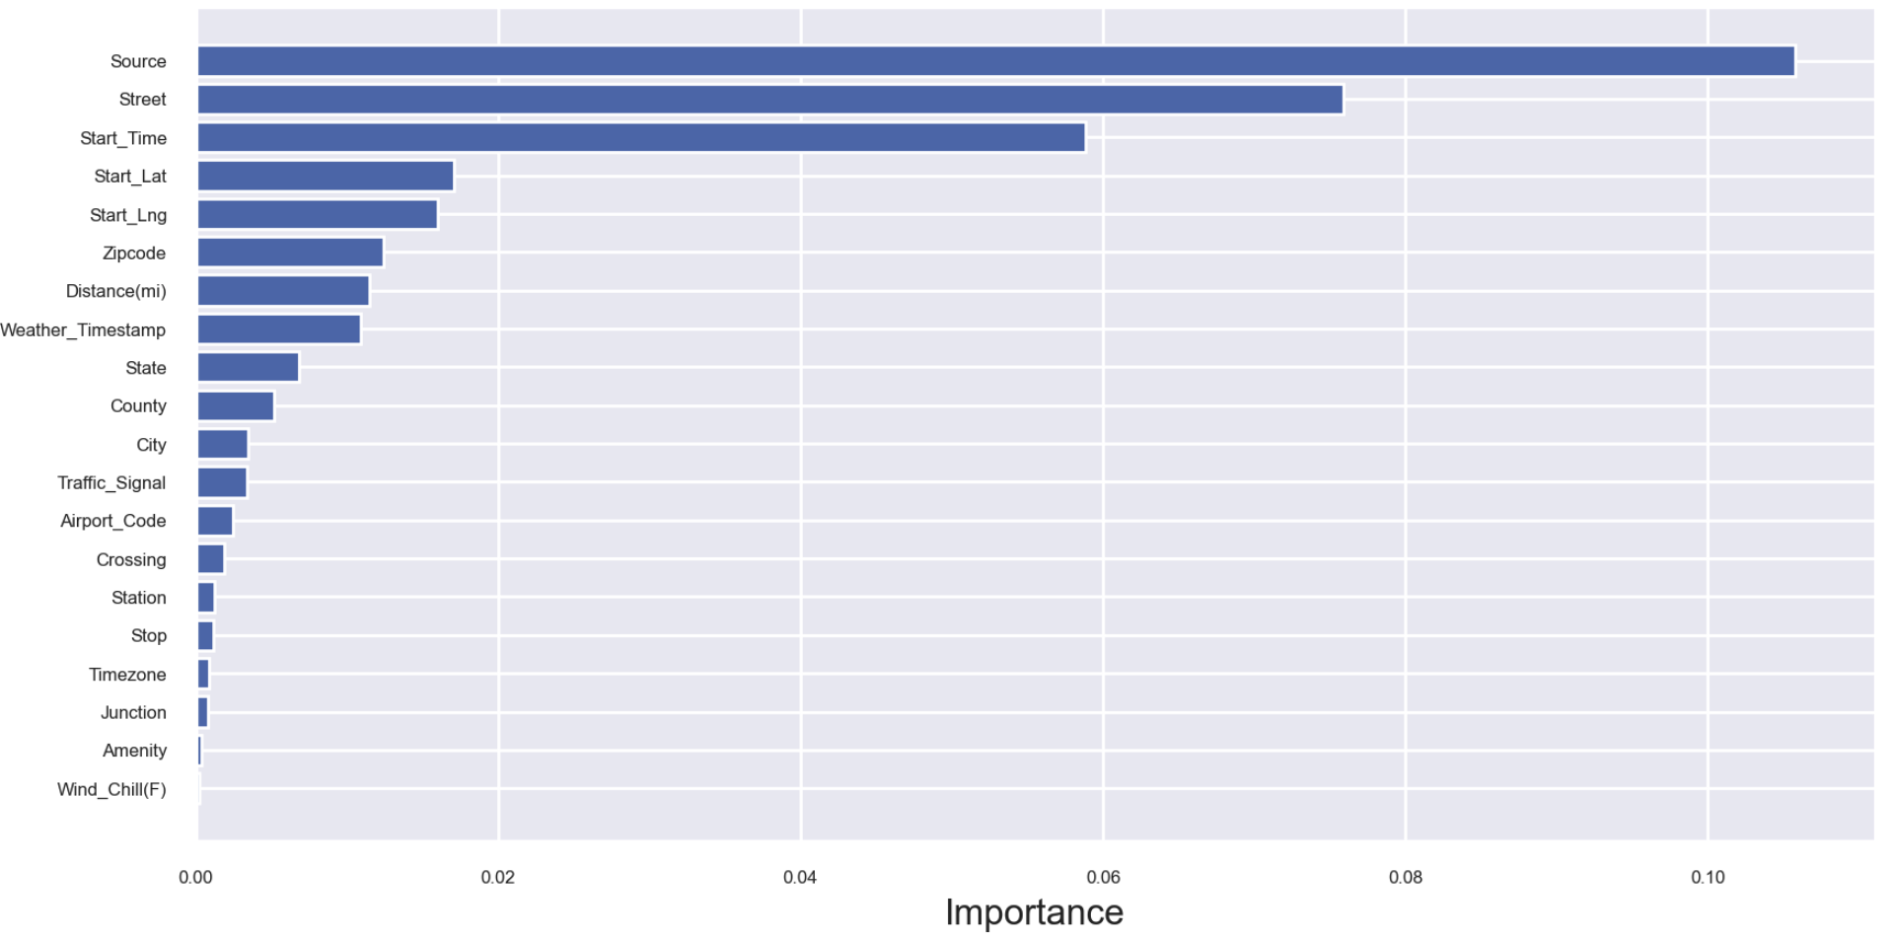
Features Importance with AutoGluon

Slide 21
Thank You
Any Questions?

